Slide 1
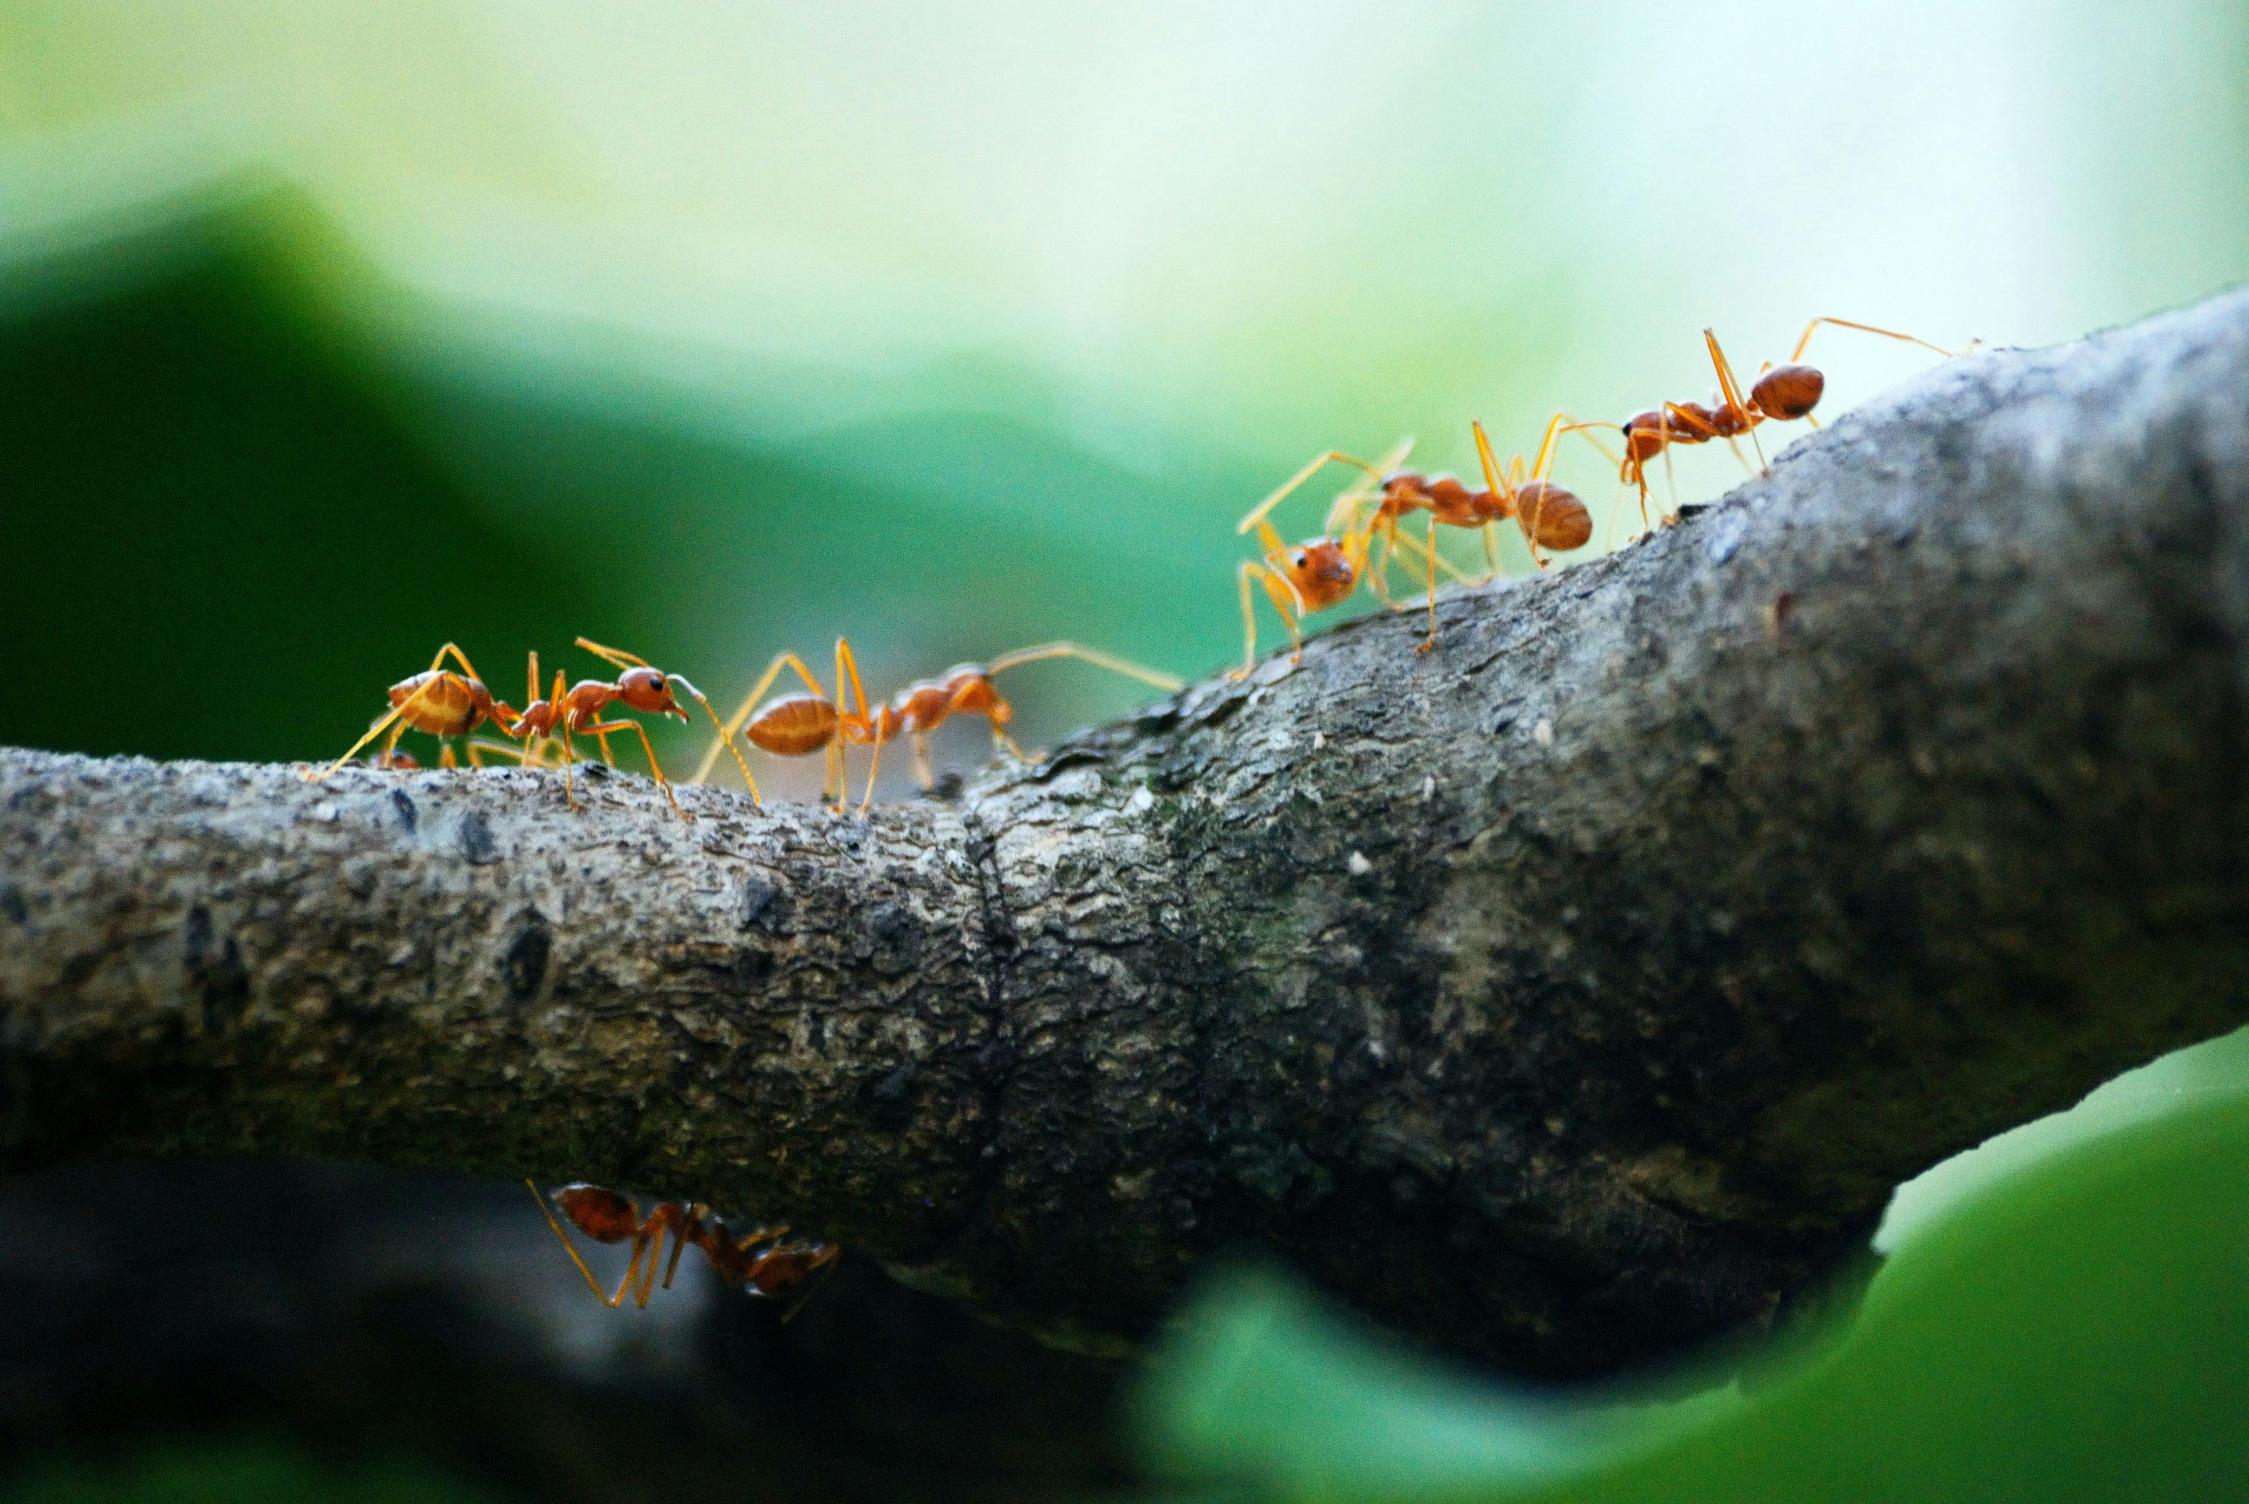

A bug’s life
An evolution simulator by Ishaan Pandey

Slide 2

How did nature come into existence?
It is a question that has puzzled humanity since the beginning of time, and up until the 19th century was only answered by useless superstitions. But in the 1850s, Charles Darwin released his theory of evolution and natural selection which finally provided a concrete answer to the age old problem.

Slide 3

The theory of Evolution

Slide 4

What is evolution?
As per the theory of evolution, new species arise from old ones based on “survival of the fittest”, that is to say an animal that is better suited to its environment is more likely to survive than one that is not suited. Sometimes when creatures are born they have random mutations which also influence their fitness for their environment.

Slide 5
The need for simulations
Our understanding of this process of evolution is crucial to the further progress of biological science.
In order to educate students and people about the mechanism of evolution, computer simulations are absolutely essential.
Thus I have created “A Bug’s Life”, an education tool that simulates the evolution of multiple species of insects.

Slide 6

About the simulation

Slide 7
The simulated ecosystem
This red creature is a carnivorous insect which hunts and eats the blue herbivores for survival. It also evolves notably.
This green ball is a plant in our ecosystem. It is eaten by herbivores. For the simplicity of the simulation, the plants do not evolve notably.
This blue creature is a
herbivorous insect which eats plants. It evolves a great deal and is the main species in the simulation.

Slide 8

Thank you

